Slide 1

Template for a Café - Leisure Square
VARCONS TECHNOLOGY PVT LTD
18CSI85
INTERNSHIP PRESENTATION
Date : 02/05/2023
1CR19CS079 KEERTHI A
Under the guidance of:
Mr Anil D
Assistant Professor
Department of Computer Science & Engineering

Slide 2
Abstract
Company – VARCONS TECHNOLOGY PVT LTD
Internship duration – 1 Month
Company Location – Bangalore
The project at hand involves redesigning the website for Leisure Square, a cafe located in Kumaraswamy Layout, Bangalore. In addition to the redesign, the client has also requested that new features be added, including a POS system for in-house orders, a table reserve on demand system, and an email and WhatsApp update tab for exciting offers and vouchers.

Slide 3
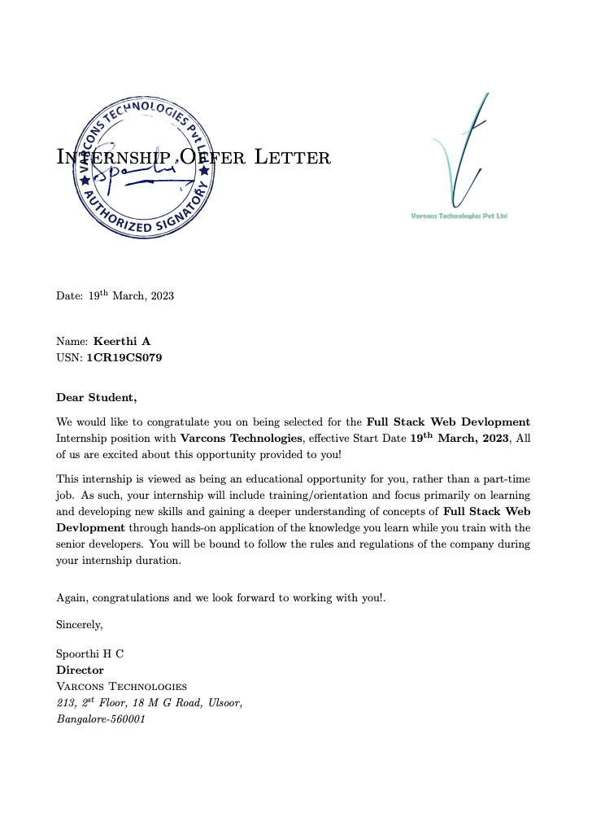
OFFER LETTER

Slide 4
Outline
INTRODUCTION
ABOUT THE COMPANY
SCOPE OF THE PROJECT
TASK PERFORMED
TECHNIQUES IMPLEMENTED
EXISTING SYSTEM
REDESIGNED SYSTEM
TOOL USED FOR BUILDING MODELS
CONCLUSION

Slide 5
INTRODUCTION
With the power of modern web technologies, we are able to design and build performing, secure, and feature rich applications that live in the cloud and bring with them a huge number of benefits.
They can be accessed from anywhere.
They are cost effective.
They benefit from more rapid update cycles.
They are secure
They enable more computing with fewer Information.

Slide 6

About The Company
Varcons Technologies is a leading provider of cutting-edge technologies and services, offering scalable solutions for businesses of all sizes.
Services they provide include
Website as Software
Search Engine Optimization
Comprehensive Customer Support
Branding and Design
Analytics and Research
Embedded Systems and IOT

Slide 7
Scope Of The Project
The proposed system involves designing general-purpose templates for a website.
The key objective is to ensure a user-friendly and easy-to-use interface.
The website should be compatible with mobile phones and other devices.
The proposed system offers an opportunity to gain experience in web design and development while meeting the client's requirements.
Successfully completing the project demonstrates the ability to design and implement functional and user-friendly websites that meet the needs of diverse users.

Slide 8
Task Performed
An alternate overall design to the existing website by using the information already available on the site: The design should be aesthetically pleasing, user-friendly, and should enhance the overall user experience.
Introducing POS System for in-house orders : This will enable the cafe staff to efficiently manage the orders and billing process. It can significantly improve the overall efficiency of the cafe.
Table reserve on demand system: The system should be user-friendly and allow customers to easily reserve a table at the cafe based on their preferred date and time. This will help the cafe manage its table bookings more efficiently and improve customer experience.
Email update tab for exciting offers and vouchers: It is used to inform customers about exciting offers and vouchers. This will help the cafe promote its services and attract new customers. The tab should be easy to use and allow customers to sign up for updates based on their preferences.

Slide 9
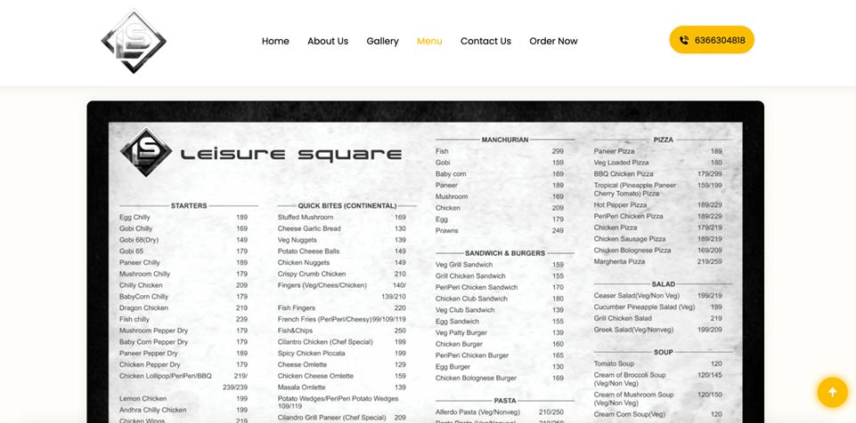
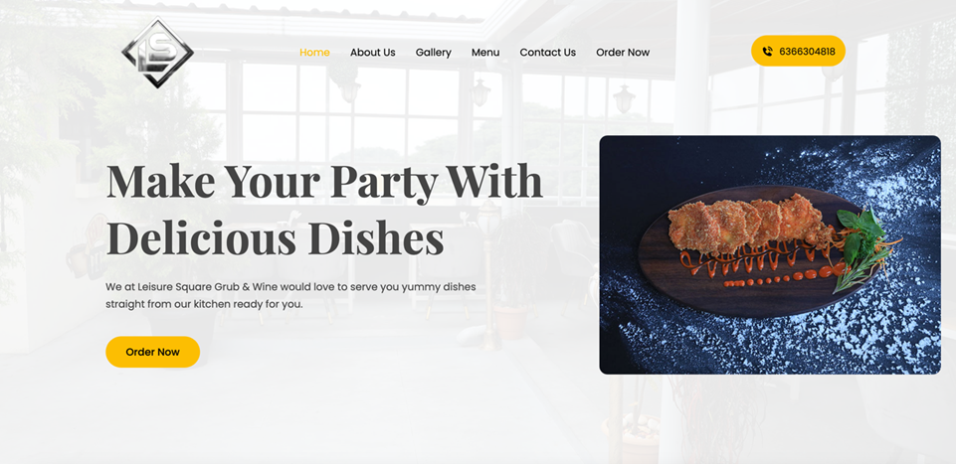
Existing System
Home Page
Menu Page

Slide 10
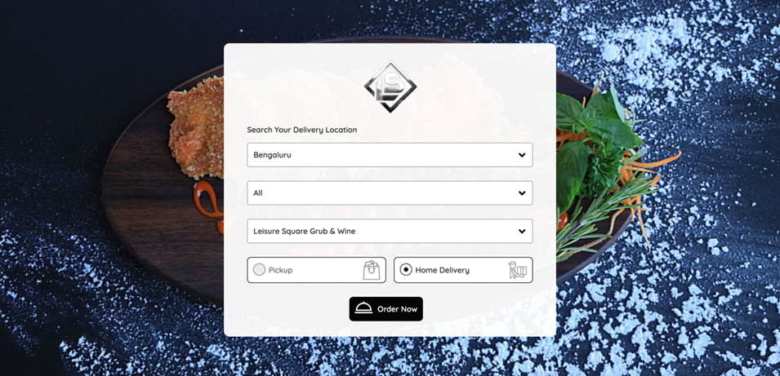
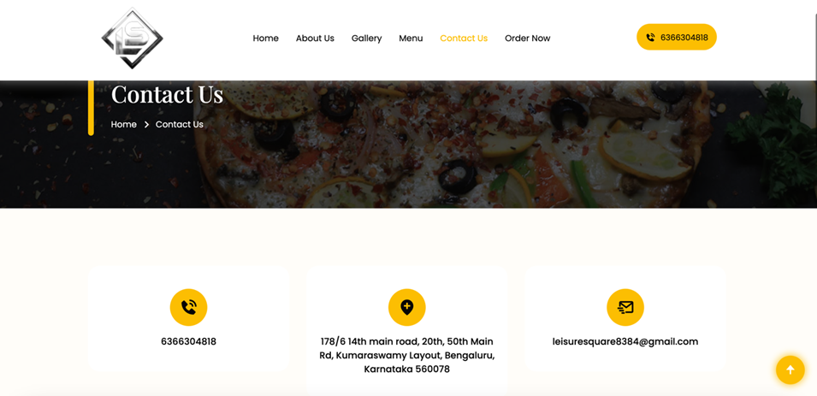
Existing System
Contact Us Page
Order Page

Slide 11
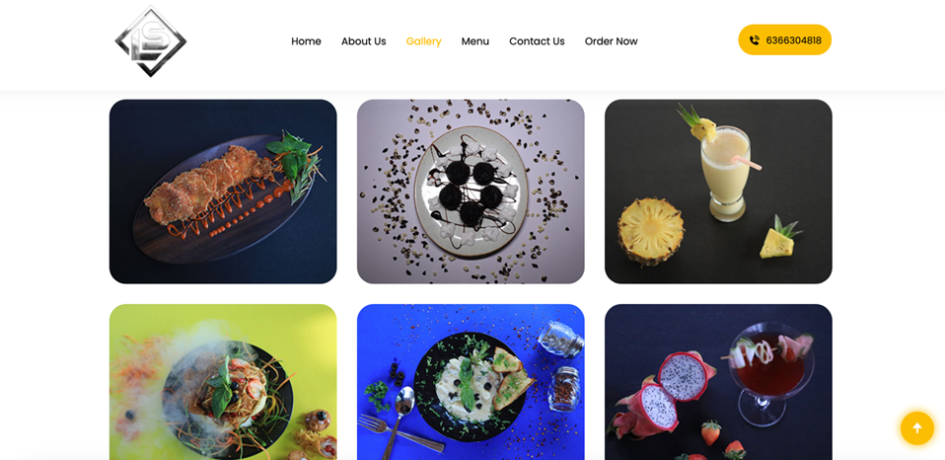
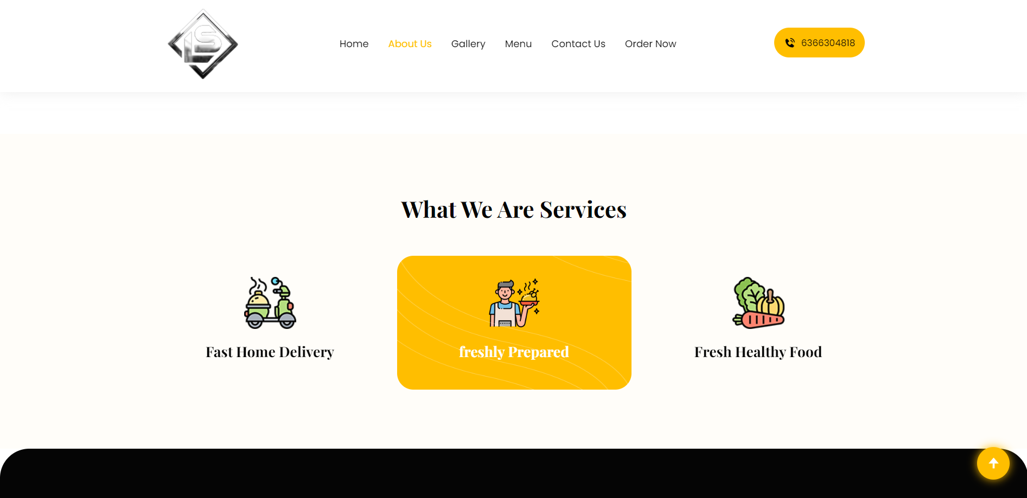
Existing System
Gallery Page
About Us Page

Slide 12
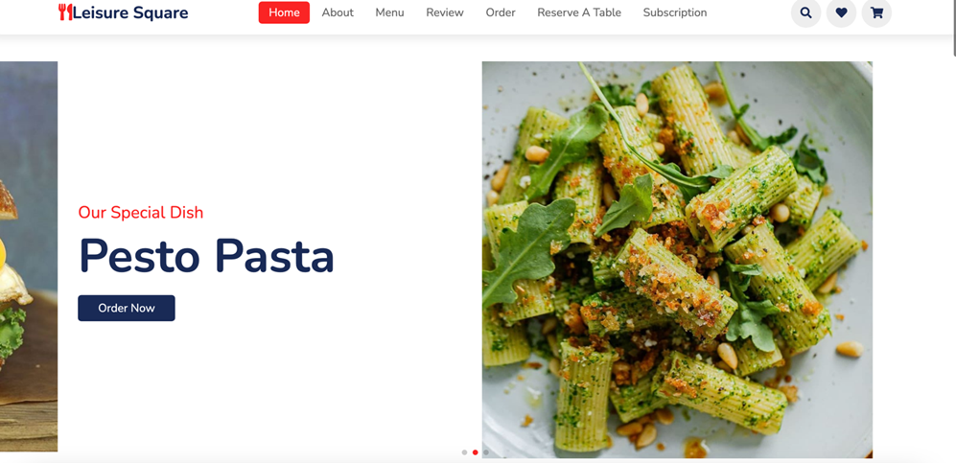
Redesigned System
Loading Page
Home Page

Slide 13
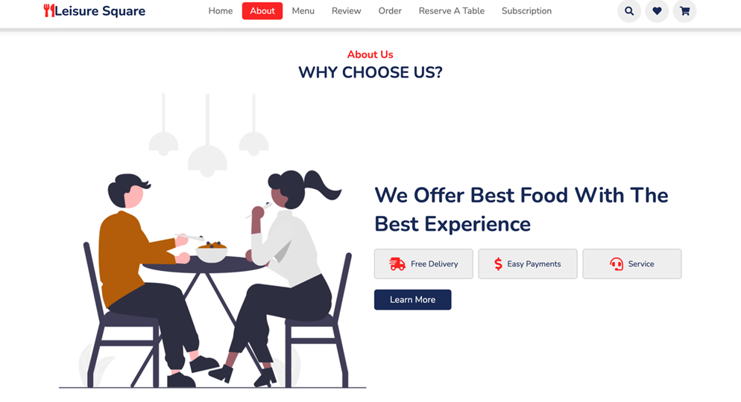
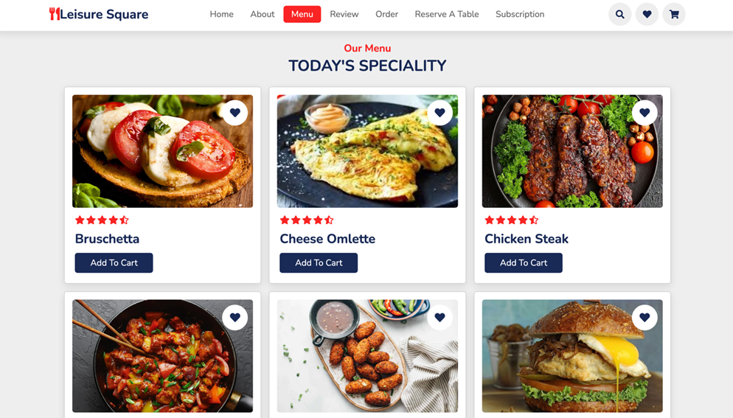
Redesigned System
About Us Page
Menu Page

Slide 14
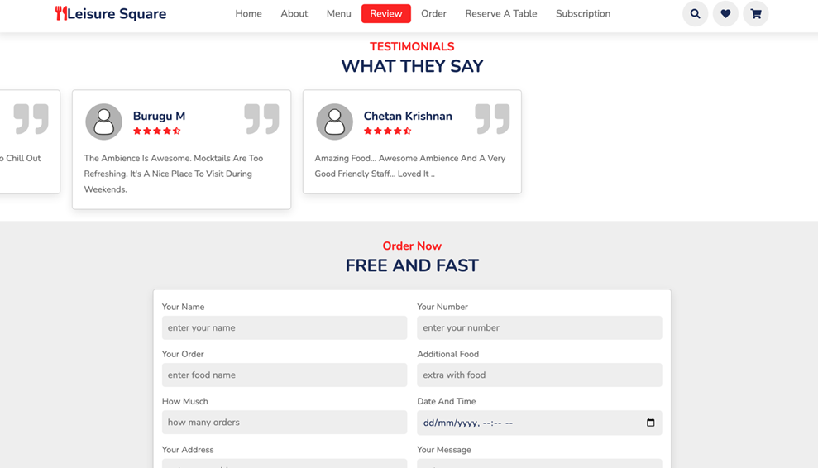
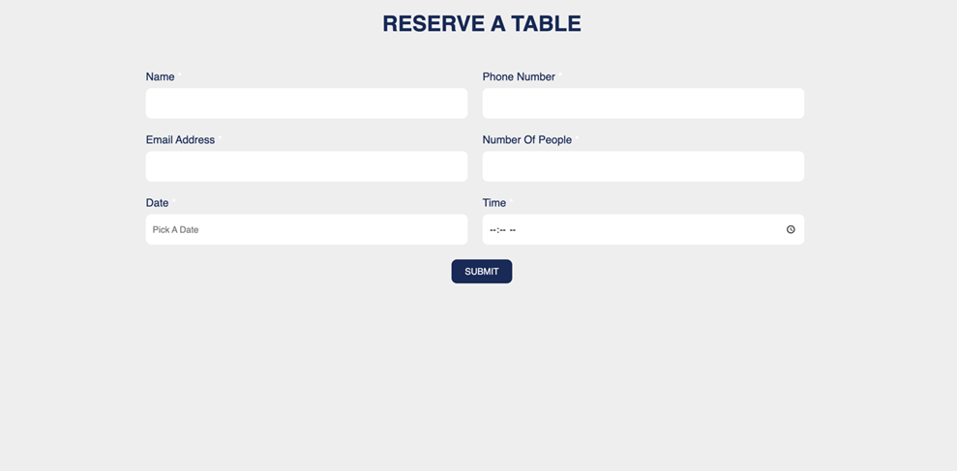
Redesigned System
Reviews & Order Page
Reserve A Table Pge

Slide 15
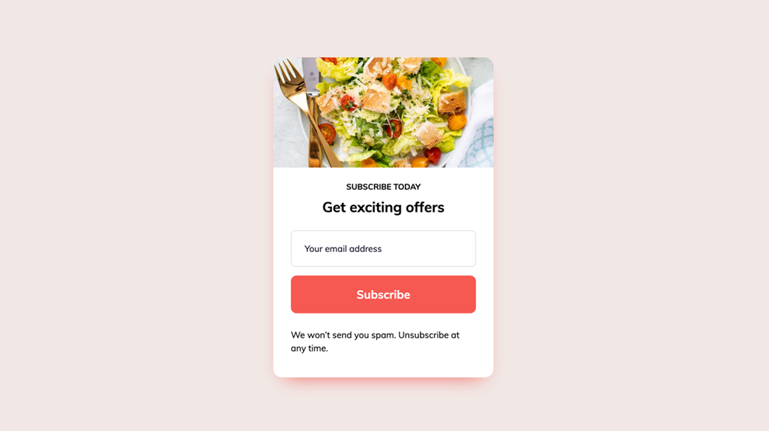
Redesigned System
Subscription Page

Slide 16
Tool Used For Building Models
Design:
Website developed using HTML, CSS, and JavaScript
Responsive design compatible with popular web browsers
Supports PDF file creation
POS System:
Developed using a programming language, Java
User-friendly graphical user interface (GUI)
Integrates with other software/hardware
Table Reservation System:
Developed using a programming language, JavaScript
Efficient table booking/cancellation handling
Email Update Tab:
Allows customers to sign up for updates
Allows staff to manage subscriptions/send updates
Complies with data privacy regulations and ensures security of customer data.

Slide 17
Conclusion
The following conclusions can be deduced from the development of the project:
Automation of the entire system improves the efficiency
It provides a friendly graphical user interface which proves to be better when compared to the existing system.
It effectively overcomes the delay in communications.
Updating of information becomes so easier.
The System has adequate scope for modification in future if it is necessary.

Slide 18
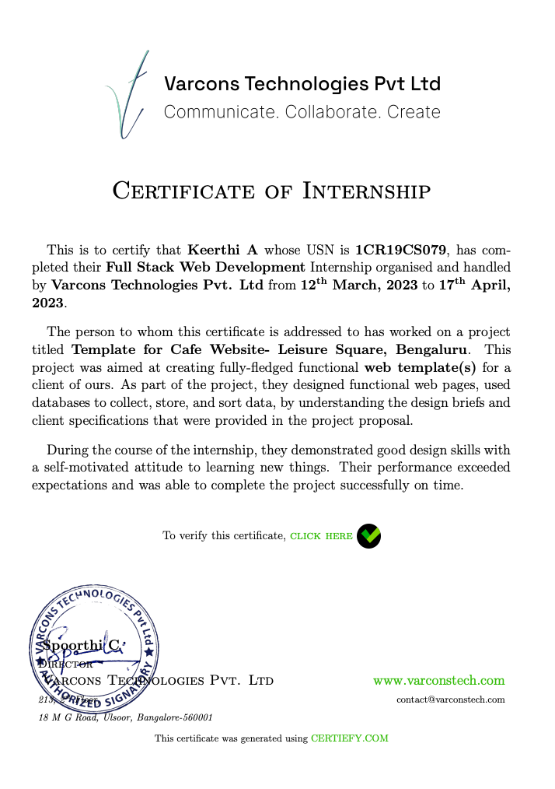
COMPLETION CERTIFICATE

Slide 19
References
https://htmldog.com/
https://developer.mozilla.org/en-US/docs/Web/HTML
https://html5up.net/
https://www.freecodecamp.org/learn/responsive-web-design/basic-html-and-html5/
https://www.codecademy.com/learn/learn-html
https://css-tricks.com/
https://getbootstrap.com/docs/5.0/getting-started/introduction/
https://fontawesome.com/icons?d=gallery
https://fonts.google.com/

Slide 20
THANK YOU

